Slide 1
Session 8 – Pandas
Versión 3.12
Msc Jorge Guerra Guerra
Data Science Instructor

Slide 2

Pandas
Porque usarlo

Slide 3

Python Libraries for Data Science
Pandas:
agrega estructuras de datos y herramientas diseñadas para trabajar con datos similares a tablas (similares a Series y Data Frames en R)
proporciona herramientas para la manipulación de datos: remodelación, fusión, clasificación, división, agregación, etc.
permite manejar datos faltantes
Link: http://pandas.pydata.org/

Slide 4
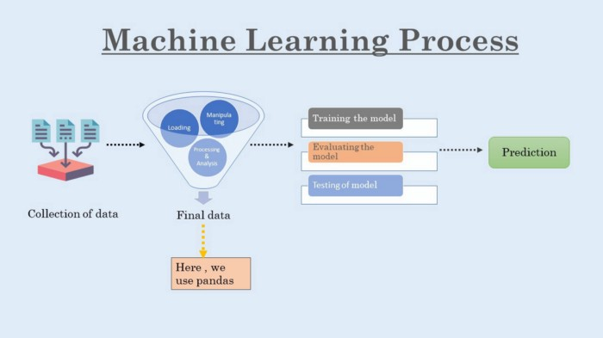

Slide 5
Reading data using pandas
In [ ]:
#Read csv file
df = pd.read_csv("http://rcs.bu.edu/examples/python/data_analysis/Salaries.csv")
Note: The above command has many optional arguments to fine-tune the data import process.
Hay una serie de comandos pandas para leer otros formatos de datos:
pd.read_excel('myfile.xlsx',sheet_name='Sheet1', index_col=None, na_values=['NA'])
pd.read_stata('myfile.dta')
pd.read_sas('myfile.sas7bdat')
pd.read_hdf('myfile.h5','df')

Slide 6
DataFrame
Un DataFrame representa una estructura de datos tabular similar a una hoja de cálculo que contiene una colección ordenada de columnas, cada una de las cuales puede ser un tipo de valor diferente (numérico, cadena, booleano, etc.).
The DataFrame has both a row and column index; it can be thought of as a dict of Series (one for all sharing the same index).

Slide 7
Pandas Data Structures
Series
DataFrame
index
values
index
columns
A | 6
B | 3.14
C | -4
D | 0
 | foo | bar | baz
A | x | 6 | True
B | y | 10 | True
C | z | NaN | False
Notes:
Series: 1-D labeled NumPy array
DataFrame: 2D table with row labels (index) and column labels (columns)

Slide 8
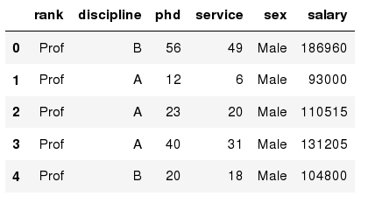
Exploring data frames
In [3]:
#List first 5 records
df.head()
Out[3]:

Slide 9
Creating Series
import pandas as pd
s1 = pd.Series([1, 2, 3, 4])
s2 = pd.Series([1, 2, 3, 4], index=[‘A’, ‘B’, ‘C’, ‘D’])
0 | 1
1 | 2
2 | 3
3 | 4
A | 1
B | 2
C | 3
D | 4

Slide 10
Creating DataFrame
df = pd.DataFrame({‘foo’: [‘x’, ‘y’, ‘z’],
‘bar’: [6, 10, None],
‘baz’: [True, True, False]})
 | foo | bar | baz
0 | x | 6 | True
1 | y | 10 | True
2 | z | NaN | False

Slide 11
Data Frame data types
Pandas Type | Native Python Type | Description
object | string | The most general dtype. Will be assigned to your column if column has mixed types (numbers and strings).
int64 | int | Numeric characters. 64 refers to the memory allocated to hold this character.
float64 | float | Numeric characters with decimals. If a column contains numbers and NaNs(see below), pandas will default to float64, in case your missing value has a decimal.
datetime64, timedelta[ns] | N/A (but see the datetime module in Python’s standard library) | Values meant to hold time data. Look into these for time series experiments.

Slide 12
Data Frame data types
In [4]:
#Check a particular column type
df['salary'].dtype
Out[4]: dtype('int64')
In [5]:
#Check types for all the columns
df.dtypes
Out[4]:
object
object
int64
int64
object
int64
rank
discipline
phd
service
sex
salary
dtype: object

Slide 13
Data Frames attributes
Python objects have attributes and methods.
df.attribute | description
dtypes | list the types of the columns
columns | list the column names
axes | list the row labels and column names
ndim | number of dimensions
size | number of elements
shape | return a tuple representing the dimensionality
values | numpy representation of the data

Slide 14
Data Frames methods
Unlike attributes, python methods have parenthesis.
All attributes and methods can be listed with a dir() function: dir(df)
df.method() | description
head( [n] ), tail( [n] ) | first/last n rows
describe() | generate descriptive statistics (for numeric columns only)
max(), min() | return max/min values for all numeric columns
mean(), median() | return mean/median values for all numeric columns
std() | standard deviation
sample([n]) | returns a random sample of the data frame
dropna() | drop all the records with missing values

Slide 15
Selecting a column in a Data Frame
Method 1: Subset the data frame using column name:
df['sex']
Method 2: Use the column name as an attribute:
df.sex
Note: there is an attribute rank for pandas data frames, so to select a column with a name "rank" we should use method 1.

Slide 16
Column Selection
 | foo | bar | baz
0 | x | 6 | True
1 | y | 10 | True
2 | z | NaN | False
df[‘foo’]
0 | x
1 | y
2 | z

Slide 17
Column Selection
 | foo | bar | baz
0 | x | 6 | True
1 | y | 10 | True
2 | z | NaN | False
df[[‘foo’, ‘bar’]]
 | foo | bar
0 | x | 6
1 | y | 10
2 | z | NaN

Slide 18
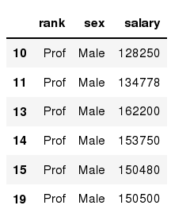
Data Frames: method loc
If we need to select a range of rows, using their labels we can use method loc:
#Select rows by their labels:
df_sub.loc[10:20,['rank','sex','salary']]
In [ ]:
Out[ ]:

Slide 19
Row Selection
 | foo | bar | baz
0 | x | 6 | True
1 | y | 10 | True
2 | z | NaN | False
df.loc[0]
foo | x
bar | 6
baz | True

Slide 20
Row Selection
 | foo | bar | baz
0 | x | 6 | True
1 | y | 10 | True
2 | z | NaN | False
df.loc[0:2]
 | foo | bar | baz
0 | x | 6 | True
1 | y | 10 | True

Slide 21
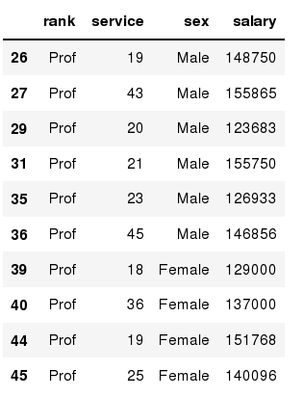
Data Frames: method iloc
If we need to select a range of rows and/or columns, using their positions we can use method iloc:
#Select rows by their labels:
df_sub.iloc[10:20,[0, 3, 4, 5]]
In [ ]:
Out[ ]:

Slide 22
Data Frames: method iloc (summary)
df.iloc[0] # First row of a data frame
df.iloc[i] #(i+1)th row
df.iloc[-1] # Last row
df.iloc[:, 0] # First column
df.iloc[:, -1] # Last column
df.iloc[0:7] #First 7 rows
df.iloc[:, 0:2] #First 2 columns
df.iloc[1:3, 0:2] #Second through third rows and first 2 columns
df.iloc[[0,5], [1,3]] #1st and 6th rows and 2nd and 4th columns

Slide 23
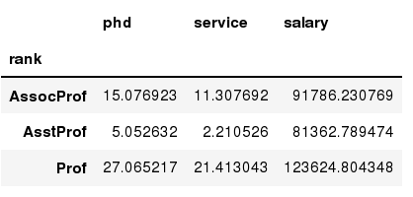
Data Frames groupby method
Using "group by" method we can:
Split the data into groups based on some criteria
Calculate statistics (or apply a function) to each group
Similar to dplyr() function in R
#Group data using rank
df_rank = df.groupby(['rank'])
In [ ]:
#Calculate mean value for each numeric column per each group
df_rank.mean()
In [ ]:

Slide 24
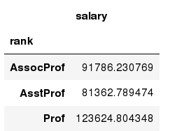
Data Frames groupby method
Once groupby object is create we can calculate various statistics for each group:
In [ ]:
#Calculate mean salary for each professor rank:
df.groupby('rank')[['salary']].mean()
Note: If single brackets are used to specify the column (e.g. salary), then the output is Pandas Series object. When double brackets are used the output is a Data Frame

Slide 25
Data Frames groupby method
groupby performance notes:
- no grouping/splitting occurs until it's needed. Creating the groupby object only verifies that you have passed a valid mapping
- by default the group keys are sorted during the groupby operation. You may want to pass sort=False for potential speedup:
#Calculate mean salary for each professor rank:
df.groupby(['rank'], sort=False)[['salary']].mean()
In [ ]:

Slide 26
Data Frame: filtering
To subset the data we can apply Boolean indexing. This indexing is commonly known as a filter. For example if we want to subset the rows in which the salary value is greater than $120K:
#Calculate mean salary for each professor rank:
df_sub = df[ df['salary'] > 120000 ]
In [ ]:
Any Boolean operator can be used to subset the data:
> greater; >= greater or equal;
< less; <= less or equal;
== equal; != not equal;
#Select only those rows that contain female professors:
df_f = df[ df['sex'] == 'Female' ]
In [ ]:

Slide 27
Conditional Filtering
 | foo | bar | baz
0 | x | 6 | True
1 | y | 10 | True
2 | z | NaN | False
df[ (df[‘baz’]) ]
 | foo | bar | baz
0 | x | 6 | True
1 | y | 10 | True

Slide 28
Conditional Filtering
 | foo | bar | baz
0 | x | 6 | True
1 | y | 10 | True
2 | z | NaN | False
df[ (df['foo'] == 'x') |
(df['foo'] == 'z') ]
 | foo | bar | baz
0 | x | 6 | True
2 | z | NaN | False

Slide 29
Data Alignment
 | a | b | c
A | 0 | 1 | 2
B | 1 | 2 | 3
C | 2 | 3 | 4
D | 3 | 4 | 5
 | a | b
A | 0 | 1
B | 1 | 2
C | 2 | 3
D | 3 | 4
E | 4 | 5
 | a | b | c
A | 0 | 2 | NaN
B | 2 | 4 | NaN
C | 4 | 6 | NaN
D | 6 | 8 | NaN
E | NaN | NaN | NaN

Slide 30
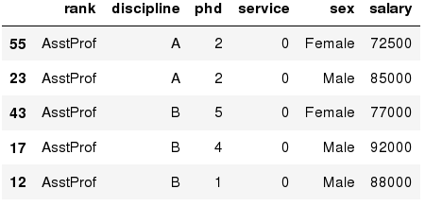
Data Frames: Sorting
We can sort the data by a value in the column. By default the sorting will occur in ascending order and a new data frame is return.
# Create a new data frame from the original sorted by the column Salary
df_sorted = df.sort_values( by ='service')
df_sorted.head()
In [ ]:
Out[ ]:

Slide 31
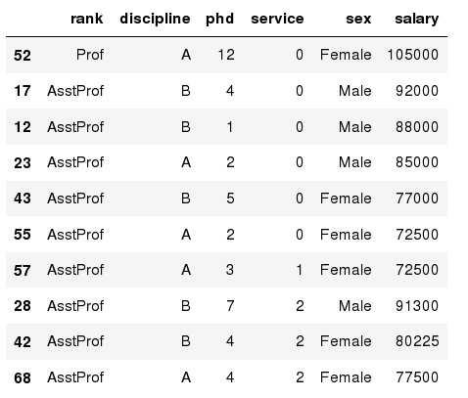
Data Frames: Sorting
We can sort the data using 2 or more columns:
df_sorted = df.sort_values( by =['service', 'salary'], ascending = [True, False])
df_sorted.head(10)
In [ ]:
Out[ ]:

Slide 32
Data Frames: Slicing
There are a number of ways to subset the Data Frame:
one or more columns
one or more rows
a subset of rows and columns
Rows and columns can be selected by their position or label

Slide 33
Data Frames: Slicing
When selecting one column, it is possible to use single set of brackets, but the resulting object will be a Series (not a DataFrame):
#Select column salary:
df['salary']
In [ ]:
When we need to select more than one column and/or make the output to be a DataFrame, we should use double brackets:
In [ ]:
#Select column salary:
df[['rank','salary']]

Slide 34
Data Frames: Selecting rows
If we need to select a range of rows, we can specify the range using ":"
#Select rows by their position:
df[10:20]
In [ ]:
Notice that the first row has a position 0, and the last value in the range is omitted:
So for 0:10 range the first 10 rows are returned with the positions starting with 0 and ending with 9

Slide 35
Handling Missing Values
new_df = df.dropna()
 | foo | bar | baz
0 | x | 6 | True
1 | y | 10 | True
2 | z | NaN | False
3 | NaN | NaN | NaN
 | foo | bar | baz
0 | x | 6 | True
1 | y | 10 | True
Notes:
By default, dropna drops all rows with any missing entry.

Slide 36
Handling Missing Values
new_df = df.dropna(how=‘all’)
 | foo | bar | baz
0 | x | 6 | True
1 | y | 10 | True
2 | z | NaN | False
3 | NaN | NaN | NaN
 | foo | bar | baz
0 | x | 6 | True
1 | y | 10 | True
2 | z | NaN | False
Notes:
By default, dropna drops all rows with any missing entry.

Slide 37
Handling Missing Values
new_df = df.fillna(0)
 | foo | bar | baz
0 | x | 6 | True
1 | y | 10 | True
2 | z | NaN | False
3 | NaN | NaN | NaN
 | foo | bar | baz
0 | x | 6 | True
1 | y | 10 | True
2 | z | 0 | False
3 | 0 | 0 | 0

Slide 38
Handling Missing Values
new_df = df.fillna(method=‘ffill’)
 | foo | bar | baz
0 | x | 6 | True
1 | y | 10 | True
2 | z | NaN | False
3 | NaN | NaN | NaN
 | foo | bar | baz
0 | x | 6 | True
1 | y | 10 | True
2 | z | 10 | False
3 | z | 10 | False

Slide 39
Handling Missing Values
new_df = df.fillna(method=‘ffill’, limit=1)
 | foo | bar | baz
0 | x | 6 | True
1 | y | 10 | True
2 | z | NaN | False
3 | NaN | NaN | NaN
 | foo | bar | baz
0 | x | 6 | True
1 | y | 10 | True
2 | z | 10 | False
3 | z | NaN | False

Slide 40
Indexing
ix = df.index
 | foo | bar | baz
0 | a | 6 | True
1 | b | 10 | True
2 | c | -2 | False
3 | d | 1 | True
0
1
2
3
Notes:
Total 9 subclasses of Index

Slide 41
Indexing
df = df.set_index(‘foo’)
 | foo | bar | baz
0 | a | 6 | True
1 | b | 10 | True
2 | c | -2 | False
3 | d | 1 | True
 | bar | baz
foo
a | 6 | True
b | 10 | True
c | -2 | False
d | 1 | True

Slide 42
Indexing
 | bar | baz
foo
a | 6 | True
b | 10 | True
c | -2 | False
d | 1 | True
df.loc[‘a’]
df.iloc[0]
bar | 6
baz | True

Slide 43
Indexing
df.set_index([[‘one’, ‘one’, ‘two’, ‘two’], df.index])
 | bar | baz
foo
a | 6 | True
b | 10 | True
c | -2 | False
d | 1 | True
 |  | bar | baz
 | foo
one | a | 6 | True
 | b | 10 | True
two | c | -2 | False
 | d | 1 | True

Slide 44
Indexing
one = df.loc[‘one’]
 |  | bar | baz
 | foo
one | a | 6 | True
 | b | 10 | True
two | c | -2 | False
 | d | 1 | True
 | bar | baz
foo
a | 6 | True
b | 10 | True

Slide 45
Indexing
one = df.loc[‘one’, ‘a’]
 |  | bar | baz
 | foo
one | a | 6 | True
 | b | 10 | True
two | c | -2 | False
 | d | 1 | True
bar | 6
baz | True

Slide 46
Transposing Data
new_df = df.T
 |  | bar | baz
 | foo
one | a | 6 | True
 | b | 10 | True
two | c | -2 | False
 | d | 1 | True
 | one |  | two
foo | a | b | c | d
bar | 6 | 10 | -2 | 1
baz | True | True | False | True

Slide 47
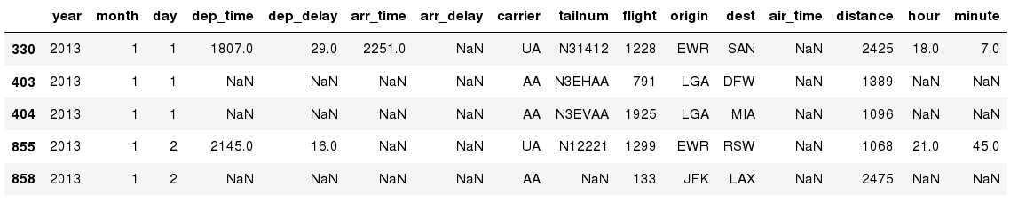
Missing Values
Missing values are marked as NaN
In [ ]:
# Read a dataset with missing values
flights = pd.read_csv("http://rcs.bu.edu/examples/python/data_analysis/flights.csv")
# Select the rows that have at least one missing value
flights[flights.isnull().any(axis=1)].head()
In [ ]:
Out[ ]:

Slide 48
Missing Values
There are a number of methods to deal with missing values in the data frame:
df.method() | description
dropna() | Drop missing observations
dropna(how='all') | Drop observations where all cells is NA
dropna(axis=1, how='all') | Drop column if all the values are missing
dropna(thresh = 5) | Drop rows that contain less than 5 non-missing values
fillna(0) | Replace missing values with zeros
isnull() | returns True if the value is missing
notnull() | Returns True for non-missing values

Slide 49
Missing Values
When summing the data, missing values will be treated as zero
If all values are missing, the sum will be equal to NaN
cumsum() and cumprod() methods ignore missing values but preserve them in the resulting arrays
Missing values in GroupBy method are excluded (just like in R)
Many descriptive statistics methods have skipna option to control if missing data should be excluded . This value is set to True by default (unlike R)

Slide 50
Statistics
df.describe()
df.cov()
df.corr()
df.rank()
df.cumsum()

Slide 51
Aggregation Functions in Pandas
Aggregation - computing a summary statistic about each group, i.e.
compute group sums or means
compute group sizes/counts
Common aggregation functions:
min, max
count, sum, prod
mean, median, mode, mad
std, var

Slide 52
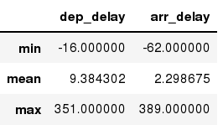
Aggregation Functions in Pandas
agg() method are useful when multiple statistics are computed per column:
In [ ]:
flights[['dep_delay','arr_delay']].agg(['min','mean','max'])
Out[ ]:

Slide 53
Basic Descriptive Statistics
df.method() | description
describe | Basic statistics (count, mean, std, min, quantiles, max)
min, max | Minimum and maximum values
mean, median, mode | Arithmetic average, median and mode
var, std | Variance and standard deviation
sem | Standard error of mean
skew | Sample skewness
kurt | kurtosis

Slide 54
Defining new functions
f = lambda x: x.max() - x.min()
print frame.apply(f)
frame.apply(f, axis=1)

Slide 55
Output
b 1.802165
d 1.684034
e 2.689627
dtype: float64

Slide 56
skipna=False
print df.mean(axis=1, skipna=False)
print df.idxmax()
print df.cumsum()
will not skip Nan
calculates mean, id of max, and cumulative sum

Slide 57
Mean, idxmax, cumsum()
a NaN
b 1.300
c NaN
d -0.275
dtype: float64
one two
a 1.40 NaN
b 8.50 -4.5
c NaN NaN
d 9.25 -5.8
one b
two d
dtype: object

Slide 58
print df.describe()
one two
count 3.000000 2.000000
mean 3.083333 -2.900000
std 3.493685 2.262742
min 0.750000 -4.500000
25% 1.075000 -3.700000
50% 1.400000 -2.900000
75% 4.250000 -2.100000
max 7.100000 -1.300000

Slide 59
Unique values, value counts, and membership
obj = Series(['c', 'a', 'd', 'a', 'a', 'b', 'b', 'c', 'c'])
print obj
uniques = obj.unique()
print uniques
print obj.value_counts()

Slide 60
Unique and counts
0 c
1 a
2 d
3 a
4 a
5 b
6 b
7 c
8 c
dtype: object
['c' 'a' 'd' 'b']
c 3
a 3
b 2
d 1
dtype: int64

Slide 61
membership
mask = obj.isin(['b', 'c'])
print mask
print obj[mask]

Slide 62
Obj, membership, filtering
0 c
1 a
2 d
3 a
4 a
5 b
6 b
7 c
8 c
dtype: object
0 True
1 False
2 False
3 False
4 False
5 True
6 True
7 True
8 True
dtype: bool
0 c
5 b
6 b
7 c
8 c
dtype: object

Slide 63
Handling missing data
string_data = Series(['aardvark', 'artichoke', np.nan, 'avocado'])
print string_data
print string_data.isnull()
string_data[0] = None
print string_data.isnull()

Slide 64
Isnull(), np.nan, None
0 aardvark
1 artichoke
2 NaN
3 avocado
dtype: object
0 False
1 False
2 True
3 False
dtype: bool
0 True
1 False
2 True
3 False
dtype: bool

Slide 65
Filtering out missing data
from numpy import nan as NA
data = Series([1, NA, 3.5, NA, 7])
print data
print data.dropna()
print data[data.notnull()]
(the last two are equivalent)

